Slide 1
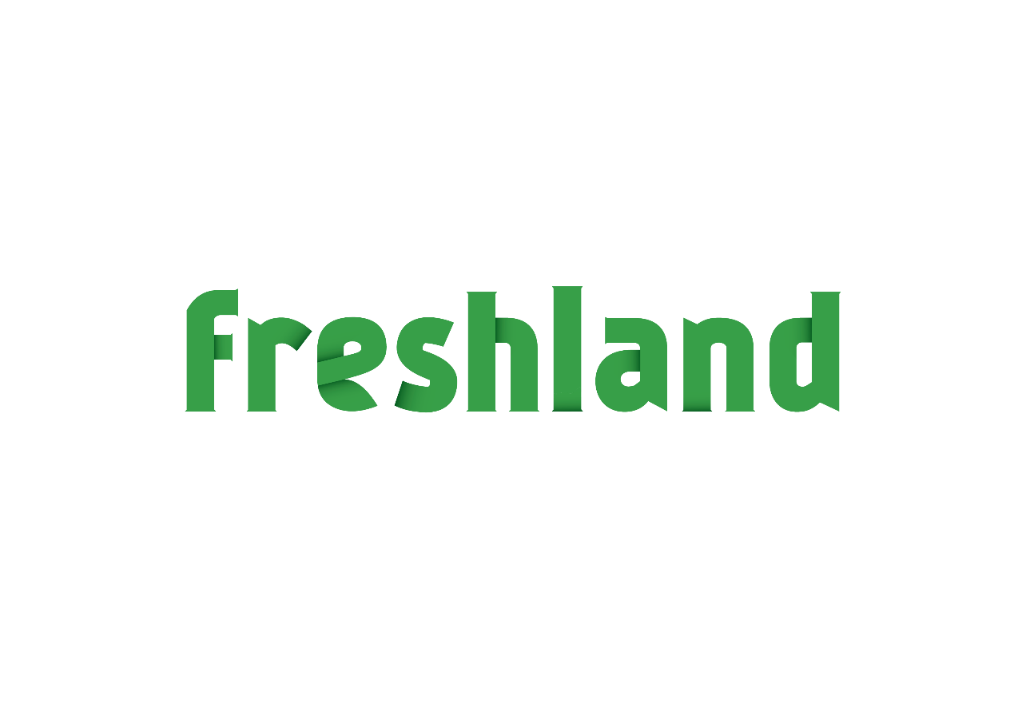
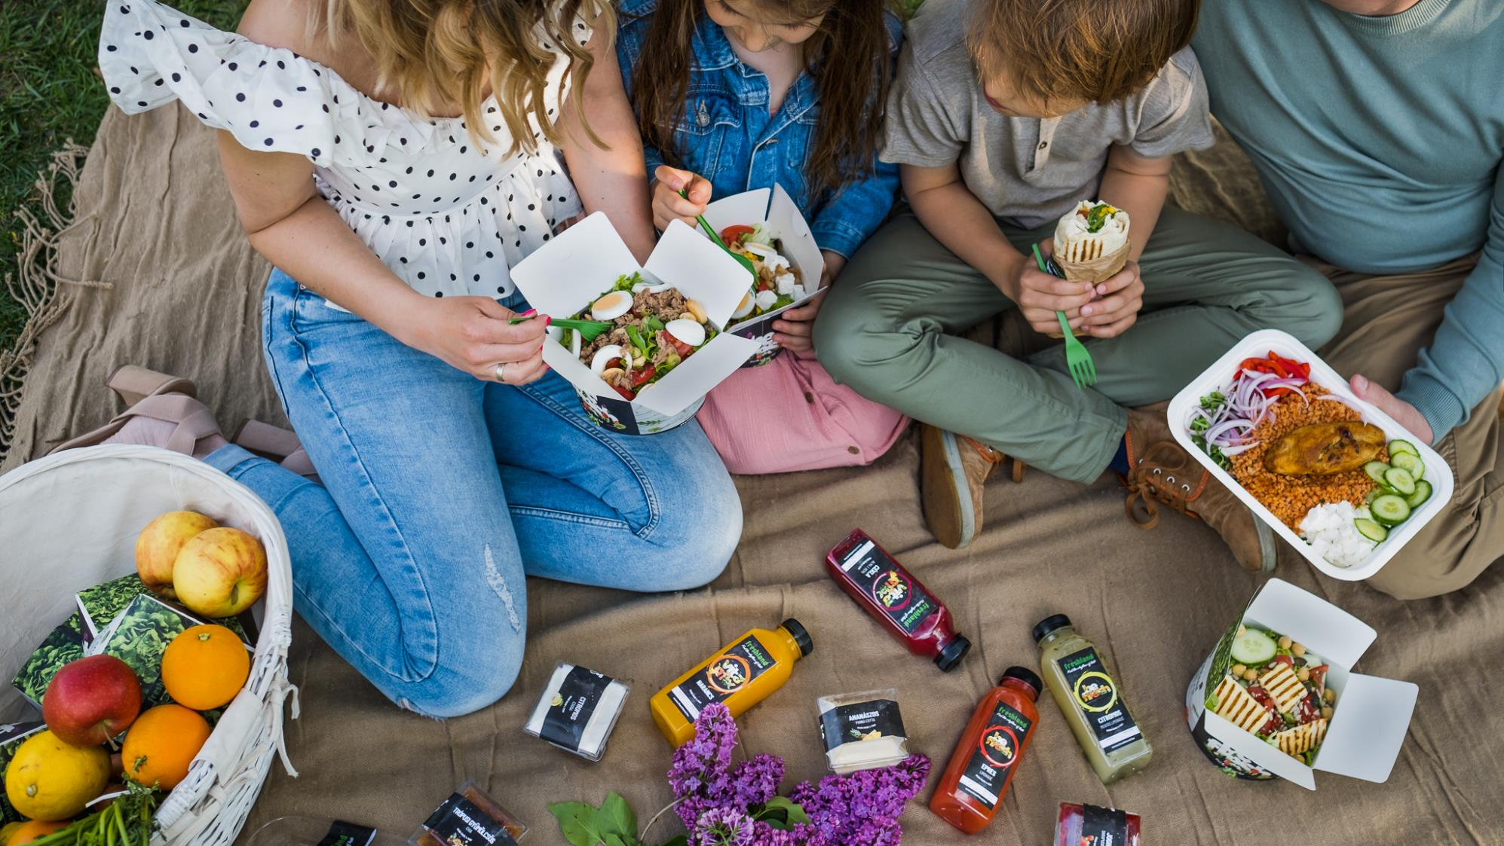

the Green Restaurant

Slide 2
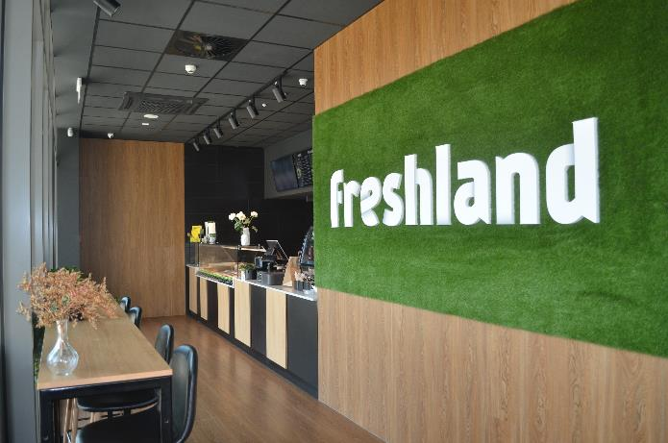
Summary
The New Freshland Concept
  Fresh Salad Bar chain – Premium, Fast, Casual Experience
  Eat well, live well! – Personalized, green, and nutritionally balanced food
  Own supply of critical green ingredients produced at High-tech Cluster Farms – Freshland Greens Factory
    Using innovative vertical hydrophonic lab technology
    Restaurants placed within a one hour radius of FGF
  The McDonald’s of the healthy food world
  Franchise based growth

Slide 3

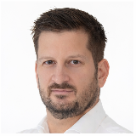
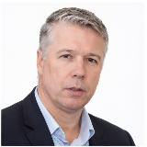
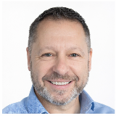
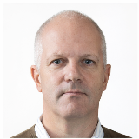
The Founder Team
Ákos Ádám
HORECA and Technology - engineer, managing factory and commercial property investments for 20 years, and for the last 10 years specifically in the HORECA and renewable energy sectors
Executive and Operations - started and built organizations, excellence in project implementation and operational management
Ákos Gyömbér
Finance – certified public accountant, tax advisor, and internal auditor
Leadership – C level leadership of both domestic and international companies, as well as non-profit orgs
Administration - professional roles in development and operation of accounting, complex taxation and financial administrative systems
László Radványi
Logistics & Supply Chain – 30+ years in transport, distribution and operational optimization across multinational environments
Leadership – Building and leading high-performance teams and managing complex end-to-end ops
Business transformation – Driving efficiency, digital transfrormation, and performance stability
András L. Szentgyörgyi
Business Development – Founded various enterprises, built regional business, global organizations
Leadership – Executive roles in international environments (Europe, North America, South America, Africa), Financial Markets – Global roles in investments, raised capital for enterprises, banking and fintech expertise

Slide 4
Pretext – yes, we have a history!
Freshland story since 2018
  Complete know-how and experience (brand, operational model, franchise model. legal entity, Freshland App)
  Senior and skilled leadership team with HORECA experience
  9 restaurants built until Covid shutdown – operating until 2023
Key learnings
  Supply chain disruption (climate crisis, unstable quality, seasonality)
  Leasing agreement traps (during COVID)
  Turbulent economy (COVID, energy crisis, financial crunch)
Solutions
  Own supply of critical ingredients – Freshland Greens Factory: high quality production all year round (‘proof of concept’: agrotech partners: Csillagváros Kft and ArianeTech Pte Ltd)
  Own locations and franchise
  Recovering economy (renewable energy, booming fast-food market, increasing green consumer segment)
  Added skills – Strategic thinking, Business Development, Executive Management, Capital Markets

Slide 5
Proof of Concept for
Freshland Greens Factory
Teaming: GE Tungsram Lighting/Csillagváros, and Freshland
Objective: test production of salads and mircogreens (core ingredients for Freshland Restaurants
Technology:
  Hydroponic farm: light, moisture, temperature, feed, digitally optimized and monitored
  Automated and mechanized labs
Results:
  All plants have been tested, optimized for growth, production
  Partners have provided Letters of Intent (commercial details available)

Slide 6
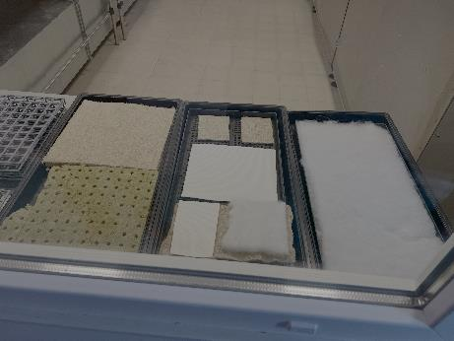
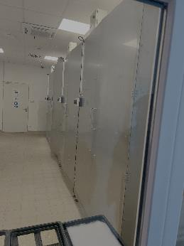
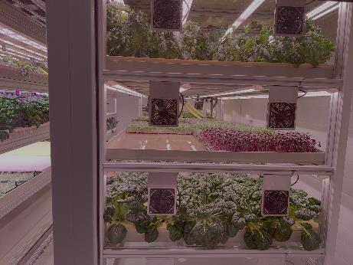
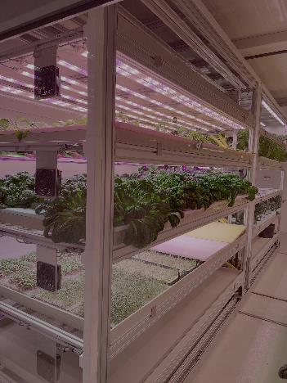
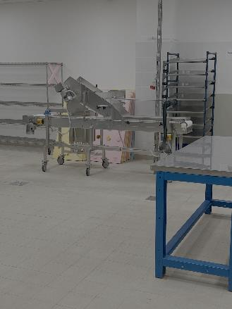
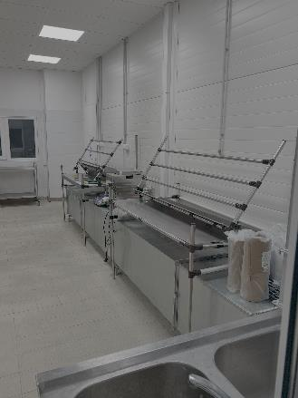
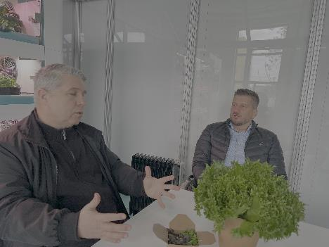
FGF Technology
Germinating pads
Germinators
Hydroponic trays
Optimized growth conditions
Looks perfect!
Tastes lovely!
Harvesters

Slide 7

Emirates Greens Factory
A substantially similar model
Storyline
  July 2022, Bustanica opens the world’d largest hydroponic plant
  Grows 1,000,000 kgs of greens per year on 30,000 sq. Meters, using 95% less water
  GreenTech – machine learning, AI, advanced agro methods
Objective: reliably, high quality greens production
Airline operating model: flying ‚restaurants’ – moving and feeding people
Sources
  https://www.emirates.com/media-centre/emirates-flight-catering-opens-worlds-largest-vertical-farm-in-dubai/
  https://youtu.be/D5XZ7Bsbnyw?si=LlFbzecCkbhVA_cH

Slide 8
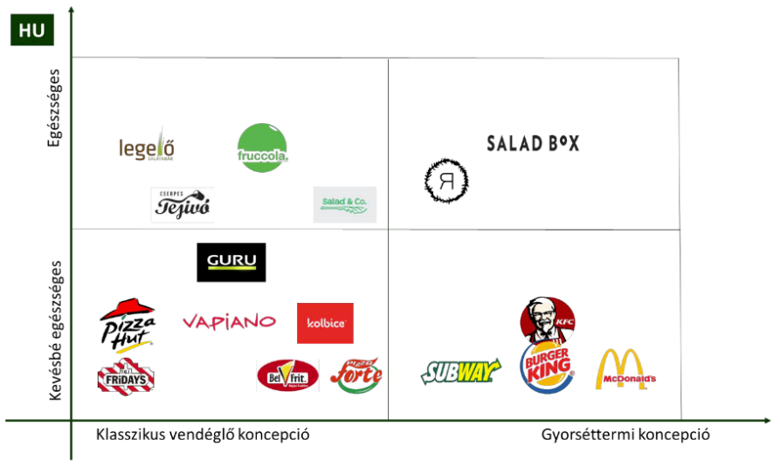

Market Analysis
Competitors
  Budapest represents a developing healthy food market with emerging competitors, yet with room for scalable franchise growth. At the regional level, Salad Box remains the top franchise model across CEE, while alternative concepts (Salad Jungle, Puzzle Salads, Street Good) offer entry points for localized adaptation.
Customer behavior
  Healthier living
  Couple effect
  Influencer culture
Healthy
Less healthy
Classic restaurant concept
Fast food concept

Slide 9
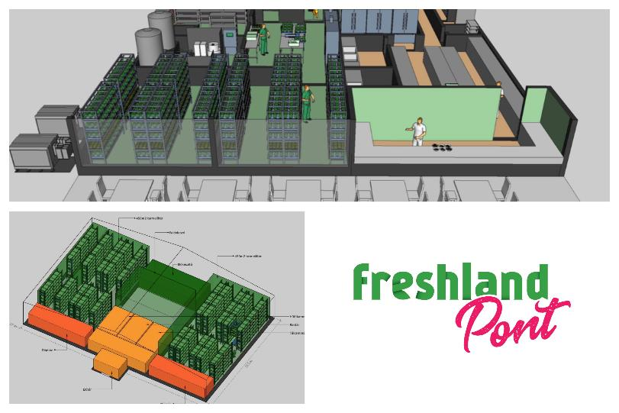
Restaurant types
Grand or Full Scale Store (modeled after Ground zero) – Production - Processing – Sales
  Own ‘model’ restaurant
  Targeted at business and office sites and
  Large footfall areas
Midstream – Cluster version
  1 large farm supplying 10 stores
  Own and franchise stores
  Located in the vicinity of existing fast food restaurants
Mini store for Pick-up – Home delivery system - Pick-up points
  Snack bar type
  Shopping mall foodcourts

Slide 10
Operational Plan
Leveraging on Experience and End-to-end Verticals: business – production – professional experience
Freshland Restaurants
Know-how
High-end fast food Technology
Design
HR
Locations
Types
Freshland Greens Factory – non-stop 365 day production*
High-tech vertical Farm
Ecological footprint
Green Energy
Climate Independent
Just-in-time, always producing
Scale of Economy
Freshland Cluster Oriented Logistics
Own supply chain of greens
Direct chain
Hygiene standards
Temperature protection
Rapid Time-to-table – within one hour

Slide 11
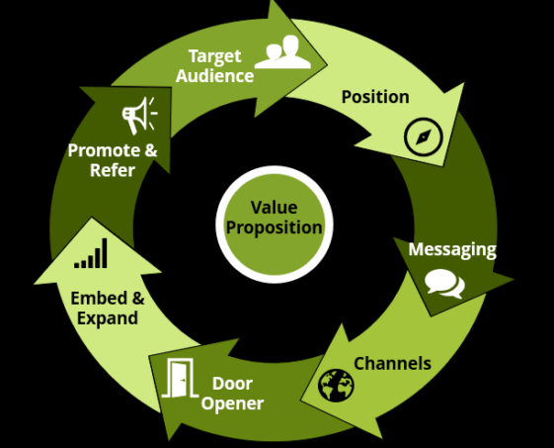
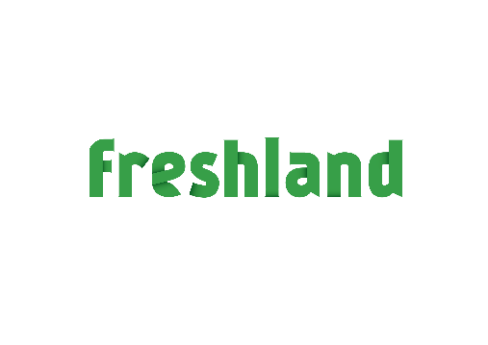
Go-to-market
Freshland Ground Zero impact
Scaling – Own and Franchise
Marketing
Brand identity
Social media impact
Growth plan
  Ground Zero within 8 months
  Regions
    10 own +10 franchise restaurants
    1Freshland Greens Factory
  Franchise model

Slide 12
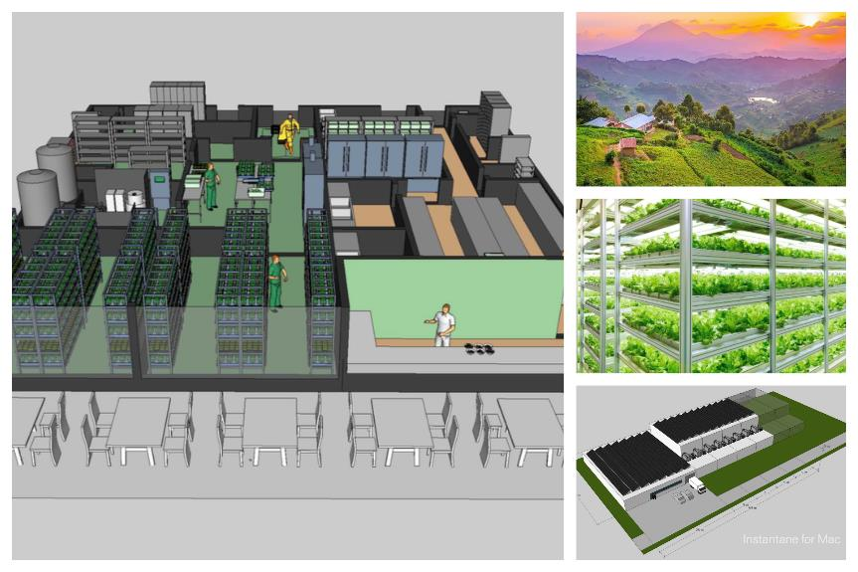
Growth plans CEE
Phase 1
  A) Ground Zero Restaurant with displayed vertical lab farm – to introduce and hype up the Freshland brand – within 8 months
  B) North-Central Region* of additional 9 restaurants in Budapest + Freshland Greens Factory
Phase 2
  A) Roll-out of additional clusters starting with the North-Western Region
  B) Continuing roll-out of remaining 2 regions (North-East, South-East)
Expansion phases
  Franchise model – parallel with initial phases
  EU and beyond (e.g.: Serbia)
  Freshland will supply other, non-green restaurant chains
  Based on established Freshland brand, retailers will be targeted with off the shelf Freshland meals and Freshland greens
All regions are cross border, in order to attain a large enough population for scaling purposes - cities from Vienna, through Bratislava to Timisoara.

Slide 13
Capital requirements for take-off
Phase 1
  Ground zero EUR 2M
Growth phase
  Along Ground Zero Franchise business can be started
Further captal involvent phases
Building resaturant chains with banking partner based on mortgage agreement

Slide 14
Financial highlights – 5 year forecast per region of 2,5-3M consumers
 | Year 0 | Year 1 | Year 2 | Year 3 | Year 4 | Year 5 | Totals
CAPEX | 2 279 001 | 1 959 481 | 2 499 114 | 1 367 544 |  |  | 8 105 140 EUR
Revenues |  | 1 417 403 | 4 732 504 | 13 557 720 | 17 908 007 | 20 594 208 | 58 209 842 EUR
OPEX |  | 1 278 309 | 3 238 616 | 8 492 200 | 10 948 945 | 12 317 968 | 36 276 037 EUR
Net Income (taxes paid) |  | 119 957 | 1 359 438 | 4 609 624 | 6 332 746 | 7 531 378 | 19 953 143 EUR
IRR 20% p.a.
NPValuation 40M EUR over 10yrs

Slide 15
Summary
We have completed
  Operational model (with underlying documentation)
  Proven Freshland Greens Factory technology (with hardware partners)
  Complete Franchise Model (Legal, Training, Distribution, Brand, etc.)
  Freshland App and Website
  Financial plan and feasibility
  Copyrighted Brand, Identity, Design, Menu
We offer a turn key restaurant business model worth 40M EUR per region, about 2,5-3 million potential consumers per region

